Slide 1
DHCP
DHCP(Dynamic Host Configuration Protocol) provides static and dynamic address allocation that can be manual or automatic.
TCP/IP Protocol Suite

Slide 2
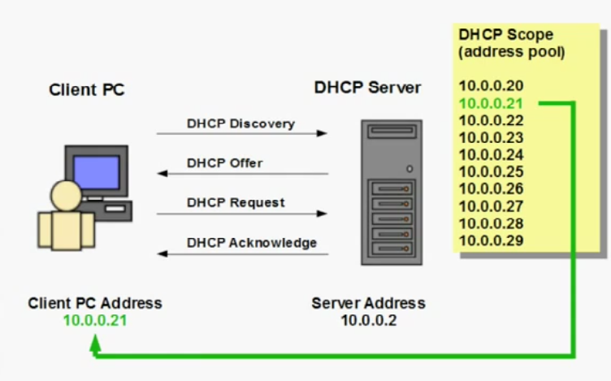
DORA PROCESS
TCP/IP Protocol Suite

Slide 3
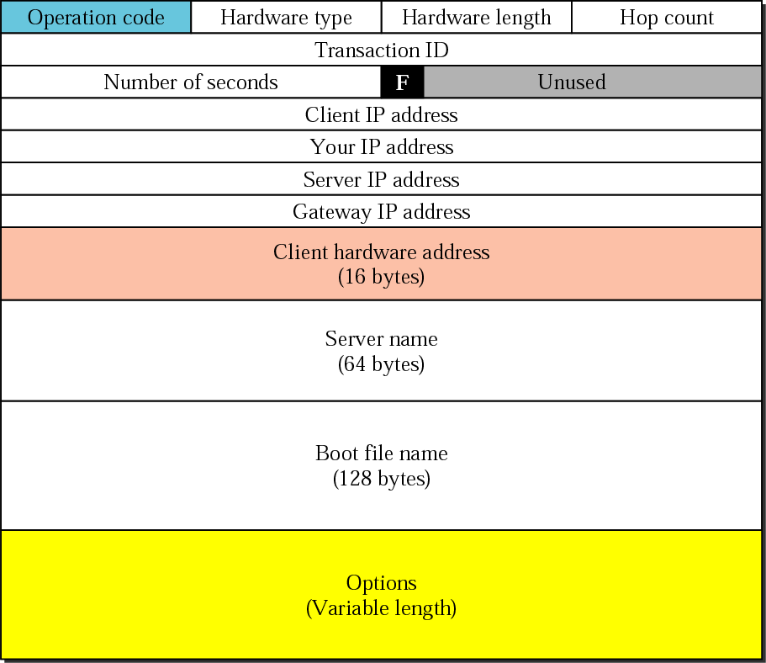
Figure DHCP packet
TCP/IP Protocol Suite

Slide 4
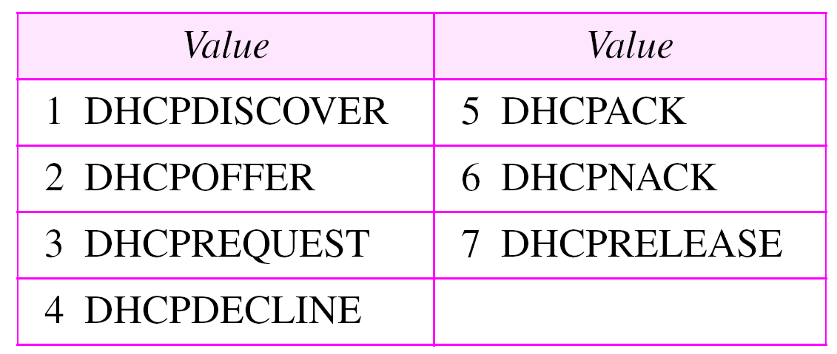
Table Options for DHCP
TCP/IP Protocol Suite

Slide 5
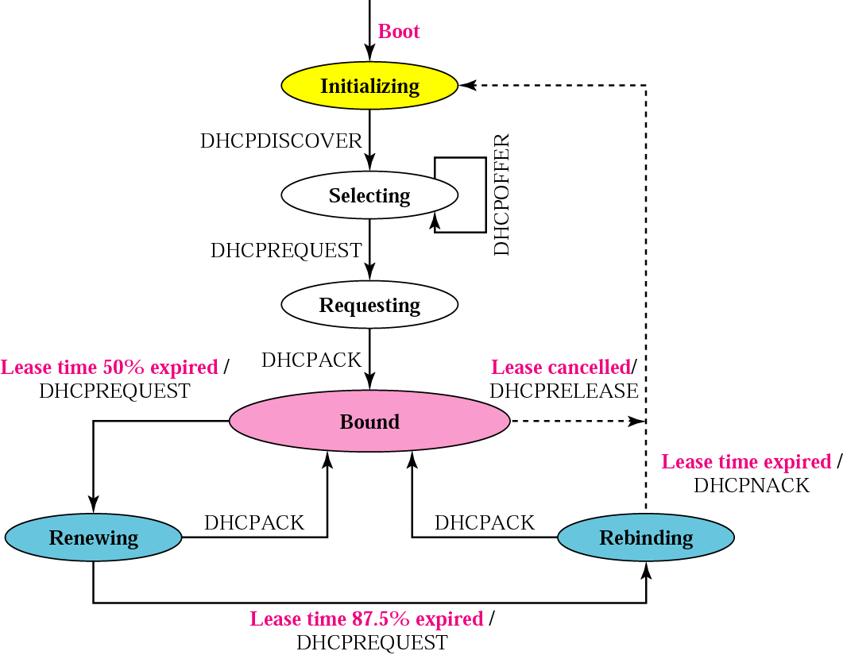
Figure DHCP transition diagram
TCP/IP Protocol Suite

Slide 6
Domain Name System: DNS
A distributed database system that can serve as a foundation for name resolution in TCP/IP network.
TCP/IP Protocol Suite

Slide 7
DNS Benefits
Conveniance-Names are easier to remember than numerical IP address.
Consistency- IP address can change but server name(s) can remain constant.
Simplicity- Users need to learn of ONLY one naming convention find resources on the Internet/Intranet.
TCP/IP Protocol Suite

Slide 8
Key Components of DNS
Domain Namespace
Zones
Name Servers
TCP/IP Protocol Suite

Slide 9
Domain Name Space
The names assigned to machines must be unique because the addresses are unique.
The domain name space is hierarchical in design.
The names are defined in an inverted-tree structure with the root at the top. The tree can have 128 levels: level 0 (root) to level 127.
The information contained in the domain name space is distributed among many computers called DNS servers.
TCP/IP Protocol Suite

Slide 10
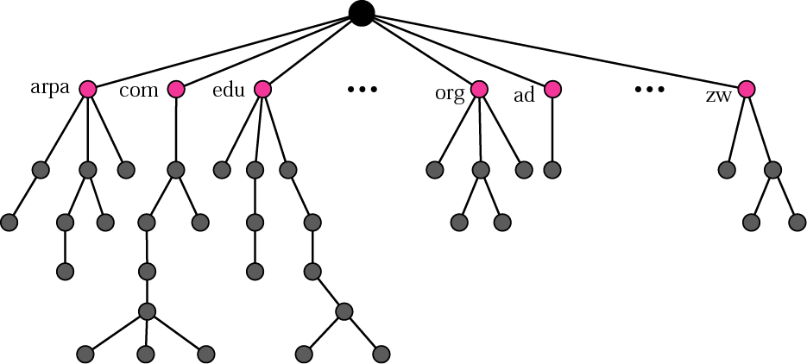
Figure Domain name space
TCP/IP Protocol Suite

Slide 11
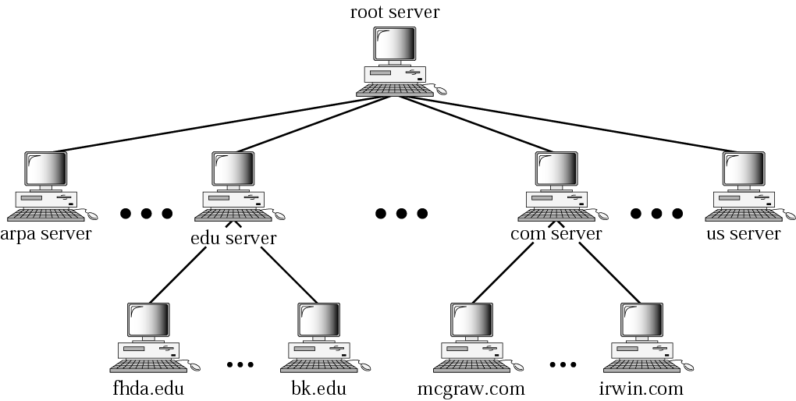
Figure Hierarchy of name servers
TCP/IP Protocol Suite

Slide 12
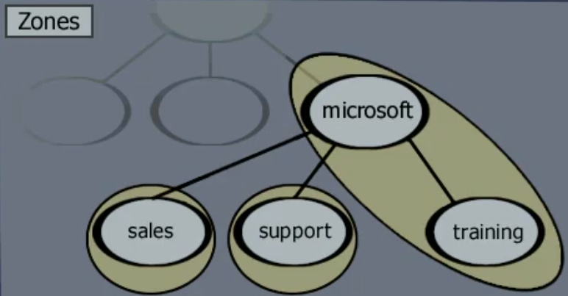
Zone – Is a discreet and contiguous area of a Domain Name space. It is easier to delegate authorities/administer to zones.
TCP/IP Protocol Suite

Slide 13
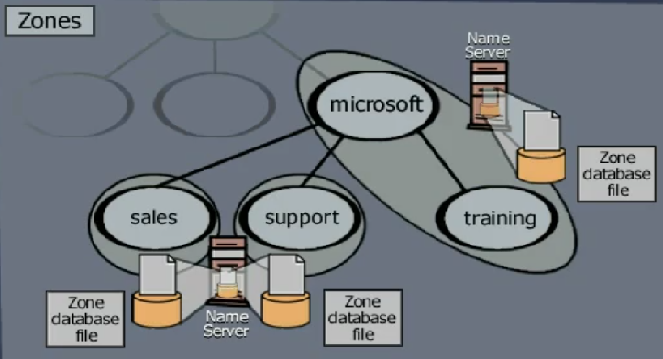
Name to IP address mapping would be stored in a Zone database file in DNS servers.
TCP/IP Protocol Suite

Slide 14
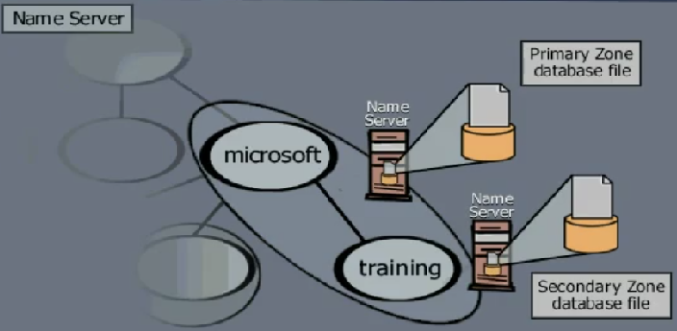
A primary server loads all information from the disk file; the secondary server loads all information from the primary server. When the secondary downloads information from the primary, it is called zone transfer.
TCP/IP Protocol Suite

Slide 15
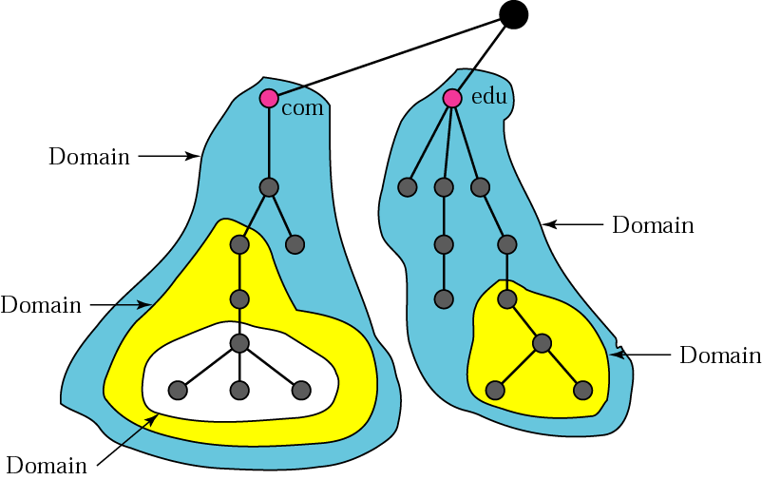
Figure Domains
TCP/IP Protocol Suite

Slide 16
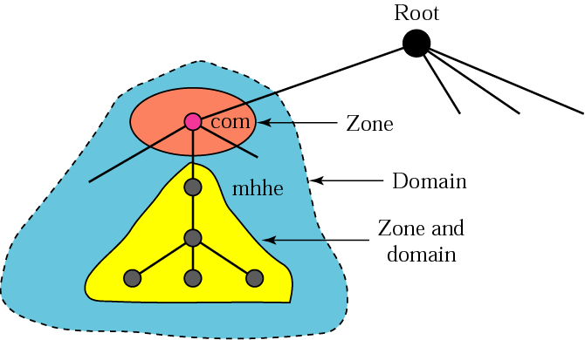
Figure Zones and domains
TCP/IP Protocol Suite

Slide 17
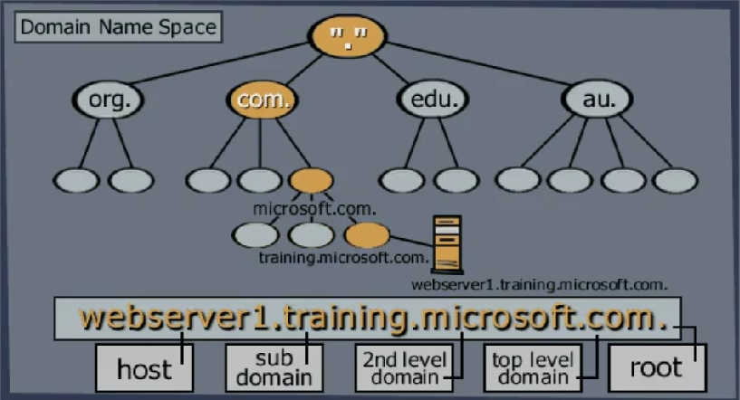
TCP/IP Protocol Suite

Slide 18
Mapping a name to an address or an address to a name is called name-address resolution.
Forward lookup query is a request to map a name to an IP address.
DNS uses UDP as the transport protocol when the size of the response message is less than 512 bytes.
If the size of the response message is more than 512 bytes, a TCP connection is used.
DNS can use the services of UDP or TCP using the well-known port 53.
TCP/IP Protocol Suite

Slide 19
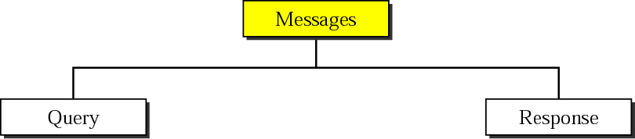
Figure DNS messages
TCP/IP Protocol Suite

Slide 20
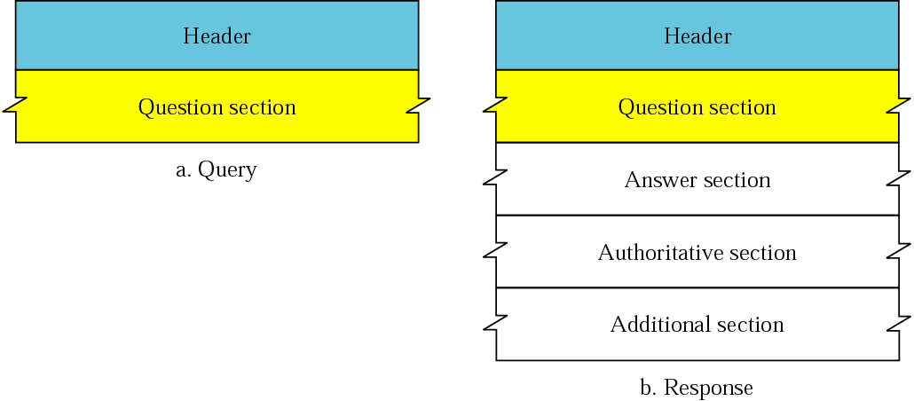
Figure Query and response messages
TCP/IP Protocol Suite

